Slide 1
PROJECT UPDATE
Topic modeling on blood work
MODELS AND ANALYSIS
Date Updated: 5 JULY 2022

Slide 2
Data summarizing

Slide 3
Data Summarizing –
Comments count according to sentiments
SENTIMENT LABEL | COUNTS | %
Positive | 16652 | 56%
Neutral | 10739 | 36%
Negative | 2350 | 8%
Questions | Counts | Total Rows | %
REASONNPSSCORE | 3390 | 29742 | 11.4%
WHATWENTWELL | 12029 | 29742 | 40.4%
WHATDIDNOTWENTWELL | 11545 | 29742 | 38.8%
11.4%
38.8%
Total at least 1 answer from all questions is given by 91% of people

Slide 4
Comments count according to Positive sentiments
% of comments in each questions
 | REASONNPSSCORE | WHATDIIDWENTWELL | WHATDIDNOTWENTWELL
Positive | 3991 | 11531 | 8942
Neutral | 270 | 2642 | 911
Negative | 957 | 2130 | 1697
 | 5218 | 16303 | 11550

Slide 5
Topics
Background: Everside wants to understand comments with positive and negative sentiments with topics associated with it
Topics: Positive
TOPIC – 1: Professionalism
TOPIC – 2: Service
TOPIC – 3 : Good doctor
TOPIC – 4: Concerns addressed
TOPIC – 5 : Engagement
Topics: Negative
TOPIC – 1:
TOPIC – 2:
TOPIC – 3 :
TOPIC – 4:
TOPIC – 5 :

Slide 6
TOPIC – 1 : Professionalism
Keywords: appointment, questions, easy, answered, dr, time, answered, questions, Able, Asked, go,
swift and courteous professional service and staff paladina the best
everything staff are very professional caring and helpful
everyone was really nice positive and very professional
everyone treated me professionally yet warmly everything went well at this appointment
everything very friendly courteous professional nothing
the nurse and doctor were both very nice and the appointment didn’t feel rushed at all great experience
during the appointment everyone was courteous very friendly and professional all my questions were answer they made me feel comfortable it was a relaxing atmosphere i have no complaints about my appointment
6

Slide 7
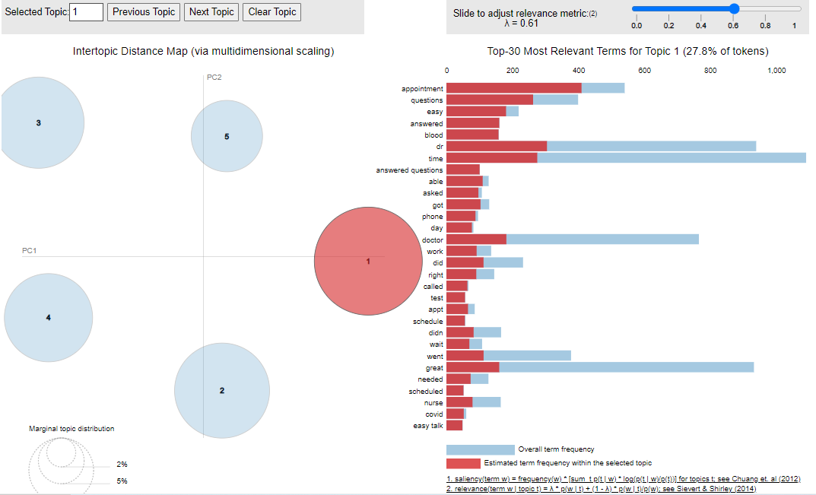

Slide 8
TOPIC – 2: Service
Keywords: feel, comfortable, felt, health, best, care, really, cared, dr, feel comfortable, doctor, rushed, just
very kind and caring provide comfortable seats
dr ritter answered all my questions and addressed all of my concerns laura was pleasant and efficient as well i know either covid they have been stretched thin but didnt take it out on me
the staff and provider were caring kind and compassionate it was as if i was visiting with a trusted friend loved it keep doing what you are doing
april has a way of making you feel relaxed and i appreciate how kind caring and professional she is everything was excellent
vision test discussion on my condition msalways excellent service
receptionist was welcoming and knowledgeable that i was coming in doctor was thorough in discussing all of my medical issuesi cant complain about anything in particular
everything that no other doctor has done before all of the above excellent care and customer servicenothing everything was perfect
the doctor is always pleasant and through receptionist is alwas friendly nothing
offered great care flu shot was very informative regarding my health needs and habits overall excellent experience
very caring quick listened
showed great care and concern for my issue
8

Slide 9
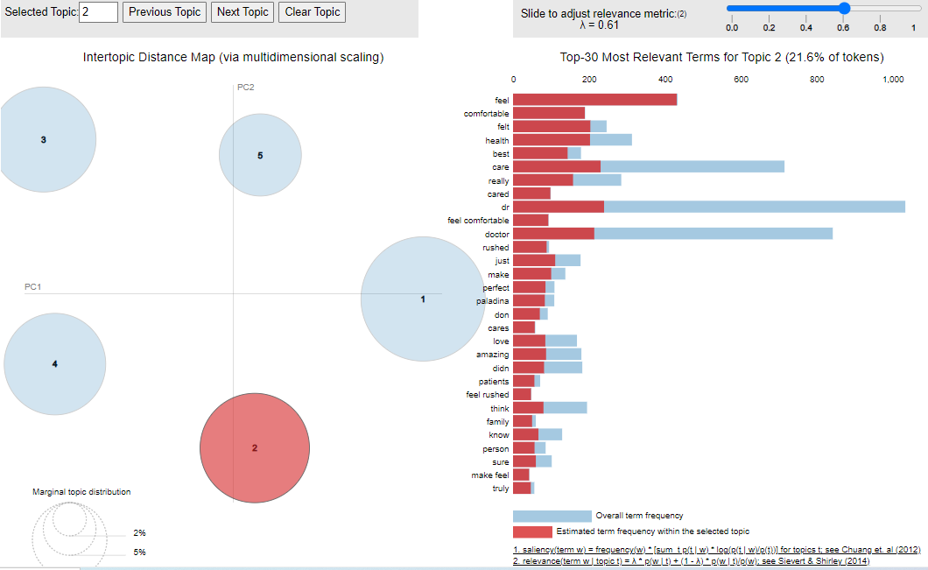

Slide 10
TOPIC – 3 : Good doctor
Keywords: friendly staff great professional courteous caring helpful nice kind knowledge able staff friendly pleasant personable friendly staff informative
Comments –
dr was very good listened to my concerns was helpful explained everything very pleased with her the nurse seemed like i was a bother to her
everyone was friendly and the doc has great bedside manners i can t think of anything that wasn t done well
appointment started right on time doctor was thorough and interested in finding out about any problems i was having nothing
everything went well i walked up early monday morning and was able to get an appointment for four hours later my appointment started on time and the doctor asked a lot of questions to nail down what was wrong this is an incredible benefit to humana employees nothing there is nothing to say it was great
dr thomas is a great listener and i always leave feeling like she understands my concerns
kim and dr carrie are both caring and compassionate i always have a good experience and am very thankful for them
great nurses great office only complaint is dr thomas has somewhat inconvenient office hours friendly prompt staff and doctor everything went fine
my appointment s always go well for me and my family thanks n a
dr plunk was wonderful to work with she was kind listened and even made me laughno complaints here
10

Slide 11
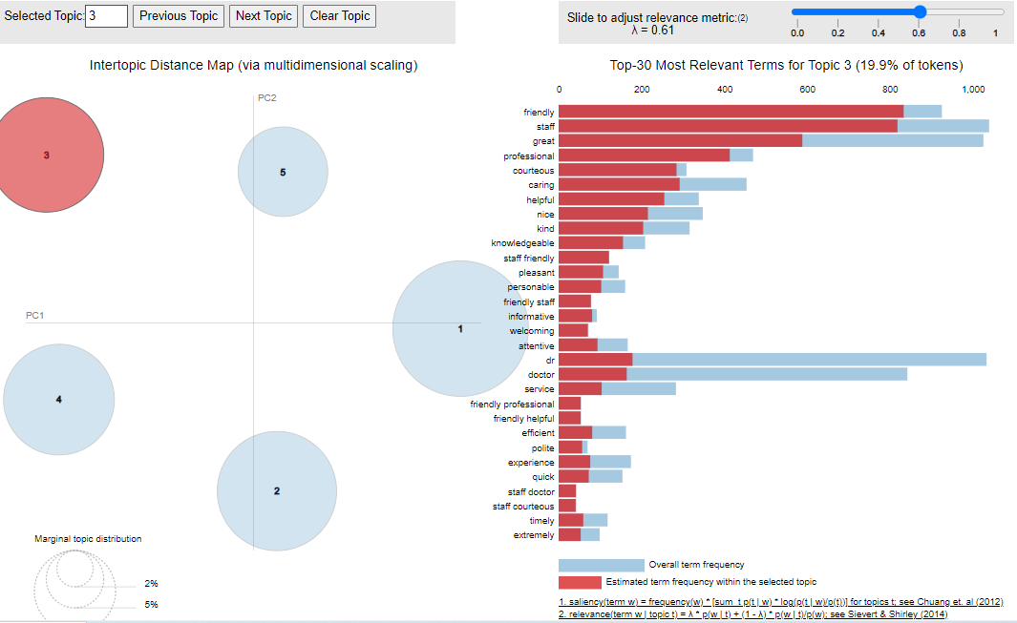

Slide 12
TOPIC – 4 : Concerns addressed
Keywords time concern stook took time listened listen went spent dr explained explain listened concerns
dr was very good listened to my concerns was helpful explained everything very pleased with her the nurse seemed like i was a bother to her
appointment started right on time doctor was thorough and interested in finding out about any problems i was having nothing
everything went well i walked up early monday morning and was able to get an appointment for four hours later my appointment started on time and the doctor asked a lot of questions to nail down what was wrong this is an incredible benefit to humana employees nothing there is nothing to say it was great
dr thomas is a great listener and i always leave feeling like she understands my concerns
kim and dr carrie are both caring and compassionate i always have a good experience and am very thankful for them
great nurses great office only complaint is dr thomas has somewhat inconvenient office hours friendly prompt staff and doctor everything went fine
my appointment s always go well for me and my family thanks n a
dr plunk was wonderful to work with she was kind listened and even made me laughno complaints here
didnt feel like a number getting passed onthe whole experience was pleasant
friendly pleasant and spend time no rush in and rush outanswers my questions
the explanation of all of the benefits of going through palladina
great nurse and convenientna
the dr and staff is great and i will not go any where else i just love them they did everything right
you did everything really well everyone at this location is always so welcoming and kind they are all a pleasure to work with always so professional kind and caring everything was great cannot think of anything that could have made it any better
tina does an excellent job taking my blood and giving vaccines she made it as painless as possible thank you for that and always pleasant dr kaushal is the best she listens to my concerns while helping me understand my meds also very kind no problems everything was good
12

Slide 13
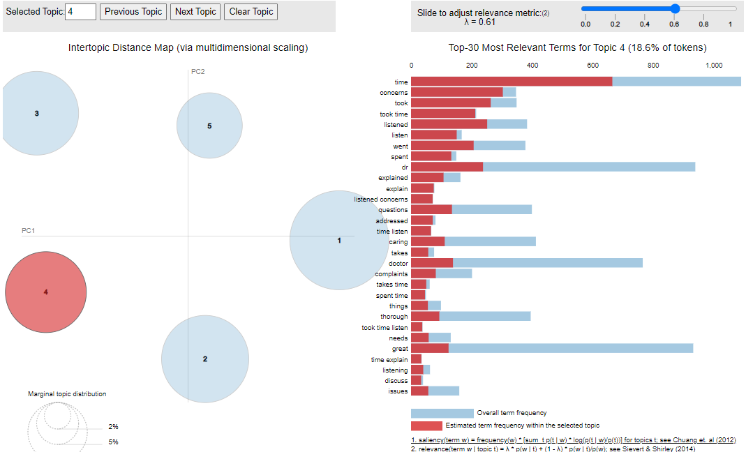

Slide 14
TOPIC – 5 : Engagements
Keywords: good, everything, nothing, care, excellent, service, thorough, personal, quality, attention, took, care
very caring staff plenty of time for me to ask questions and get straight forward answers nothing
the doctor and the staff spent a lot of time with me and made sure i had all of my concerns addressed i didnt feel rushed i felt like the appointment was very thorough
it was quick on time friendly and very informative i had to wait several weeks before i could get an appointment
not very convenient with limited time availability meet all my requests
paula and stephanie are amazing your an actual person with them and not just a number on a chart
i feel like i always have dr dealleaume s complete attention i had just had surgery and it was nice to get answers to things
enjoyed meeting with the doctor and staff this appointment was to establish with a new doctor
paid attention to my input and my medical history appeared knowledgeable kind courteous and personable
i liked that dr mccay spent a lot of time with me explaining things to me in depth
awesome interaction with the front office person and the np very nice people took their time and were very attentive overall great experience
i liked that when i passed out the staff was responsive and made sure that i had everything that i needed to feel safe and comfortable
14

Slide 15
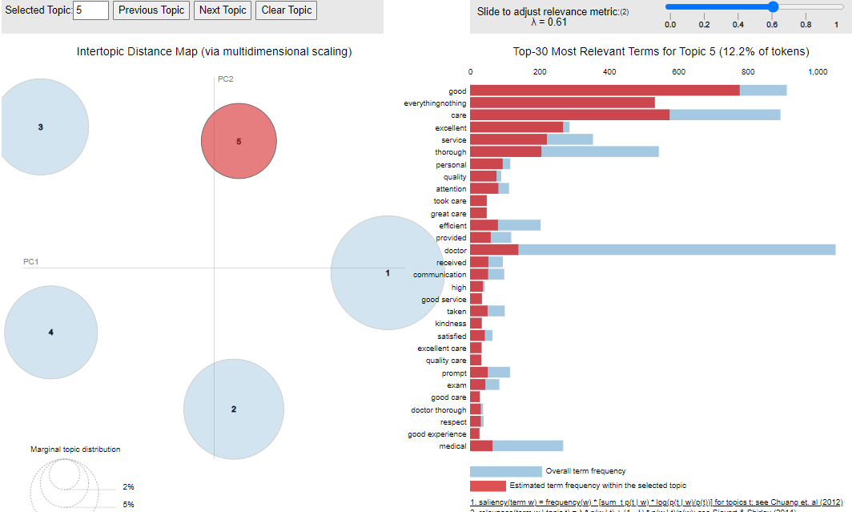
15

Slide 16
TOPIC – 1 :
Keywords:

Slide 18
TOPIC – 2 : Delay in blood work
Comments associated with this topic :
"I lowered my score for the following reasons:
1. The health center does not have my historical medical records. This is really unacceptable.
2. The day I went in to give blood for my physical, I was left waiting for 20 minutes only to be told by the lab tech that ""this new system"" had marked me off as completed, so she didn't know I still needed to give blood. She realized it only when calling another patient.
3. The check-in person attempted to give me paperwork to fill out, but when I mentioned I had completed some on line, she pulled certain papers out of the packet for me to fill out. She should have known what she did and did not need.
4. The nurse failed to take my temp and blood pressure while she took down other information prior to my appt. with the doctor.
The reason my score was as high as it was is that I really like Dr. Browne.“
2) I waited about 30 minutes before appointment when knowing that i had done the pre-enrollment by phone. In addition, the nurse that i was supposed to see left because it was the end of her shift... although my appointment was on her schedule. once i saw the technician for the screening, i waited under 15 min... anyhow, we did blood test which i had to wait under 15 min... i was alone in the clinic.. so not sure why it was so disorganized
3) The nurse was unable to draw my blood. He also almost gave me a flu shot and tetanus injection while waiting to hear back from the doctor. I had to remind him he was waiting. The doctor said not to give them due to a conflict with prednisone. He was apologetic but that was a little unnerving that he could have given me a shot if I had not said something.
4) When I schedule a blood draw appointment early in the morning I do it for the reason of I have to be at work at a certain time. When I am approached unexpectedly with other questions regarding my primary care it took away from the real reason I was there.
5) Came in 10 min early for first appointment. Filled paperwork and still had to wait 30 min to see the doctor. Follow up was also subpar. After missing his call he said he would try later to call back. Never called and finally recieved a letter 2 weeks later with my bloodwork. No followup on what the numbers mean or if I should do a follow up appointment.
18

Slide 19
TOPIC – 3 : Fasting related issuses before blood work:
Topic 3 is about, Not notified to do fast for accurate results of blood work
1) I wish Laura Gruber (Dr. Ritters nurse) was there. She knows me and I appreciate her care and knowing my history. The nurse that did blood work did so without warning. Also, she didnt check to see if I was fasting for my blood work. I think the care there could be better.
2) Focus on preventative services. My lipids panel was not included my fasting blood work.
3) Rescheduled me from 10:30 to 11:30 which was not ideal given I was fasting for a blood test
4) I scheduled my annual check-up via the web portal. It would be nice if there was a reminder about possibility of fasting for some types of blood draws, that patients should still check with the clinic for specific instructions before their appointment.
5) I was not notified that should be fast for my appointment to take some blood.
6) It bothered me that I had a complete physical without being asked to undress. As a nurse, I feel that many findings could be missed on patients.
In addition, I had routine fasting labs drawn. The staff did not ask me for any patient identifiers (name, date of birth) before drawing my blood. I also noticed that the tubes of blood were not labeled prior to drawing my blood. While I was the only patient in the office at the time of my visit, I felt uncomfortable with the process.
This is also the 3rd provider I have seen since I started coming to Paladina. There seems to be a high turnover.
I may look back into re-establishing with my previous PCP with Atrium prior to my next annual exam.
19

Slide 20
Major Blood work negative comments vs States
Major Blood work negative comments vs Region

